Slide 1

Homework 2 Email INT4023
Dalton Murray

Slide 2
Establishing basics

Slide 3
Establishing basics

Slide 4
Authentic users & Unauthentic
We are given two known people and their emails, Alex Rai, and Julia Suzuki, and their verified emails. All others are unauthentic.
Alex Rai - alexrai@raiandco.club
Julia Suzuki – JSuzuki@securelymanaged.com

Slide 5
What happened?
Alex sent a hard copy of wire instructions to Julia
Julia received these instructions
An attacker sent Alex a message saying they will not be able to transfer the funds until the next week
Julia received a message from the attacker saying they sent the wrong information for the wire transfer
Julia wires the money to the new information
Julia and Alex ask if they received the money/when they will be receiving the money
They reviewed previous emails and found emails not sent from Alex and Julia to each other

Slide 6
Timeline of emails
Monday 2/18/2019 9:55 AM Alex -> Julia
Monday 2/18/2019 11:14 AM Alex <- Julia
Monday 2/18/2019 12:05 PM Alex <- Attacker (rcozart@themoviecountdown.com)
Monday 2/18/2019 12:06 PM Alex -> Julia
Thursday 2/28/2019 11:44 AM Alex -> Julia
Thursday 2/28/2019 12:01 PM Alex <- Julia
Thursday 2/28/2019 12:04 PM Alex -> Julia
Thursday 2/28/2019 12:08 PM Alex <- Julia
Thursday 2/28/2019 12:09 PM Alex <- Julia (Forwarded messages)
Monday 2/18/2019 11:45 AM Julia <- Attacker (New wiring instructions)
Monday 2/18/2019 11:48 AM Julia -> Attacker (Saying will send to new wiring instructions)
Monday 2/18/2019 12:09 PM Alex -> Julia
Thursday 2/28/2019 1:01 PM Alex -> Julia

Slide 7
Future proofing

Slide 8
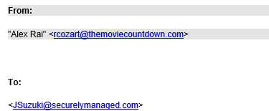
First method
Look at who is sending you emails
Should do this for every email received
This will usually fix any potential problems in the future
Make sure to look at email address, not just name
This shows a person has the name Alex Rai, but is not Alex Rai as the email address is not correct

Slide 9
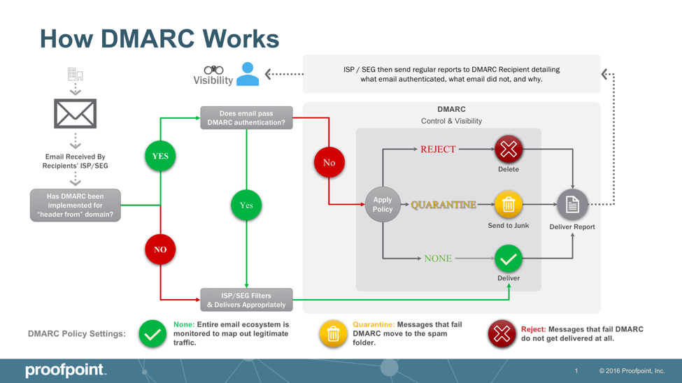
Second method
Putting in proper email spoofing and verifications on both ends
SPF
DKIM
DMARC
DIMI

Slide 10
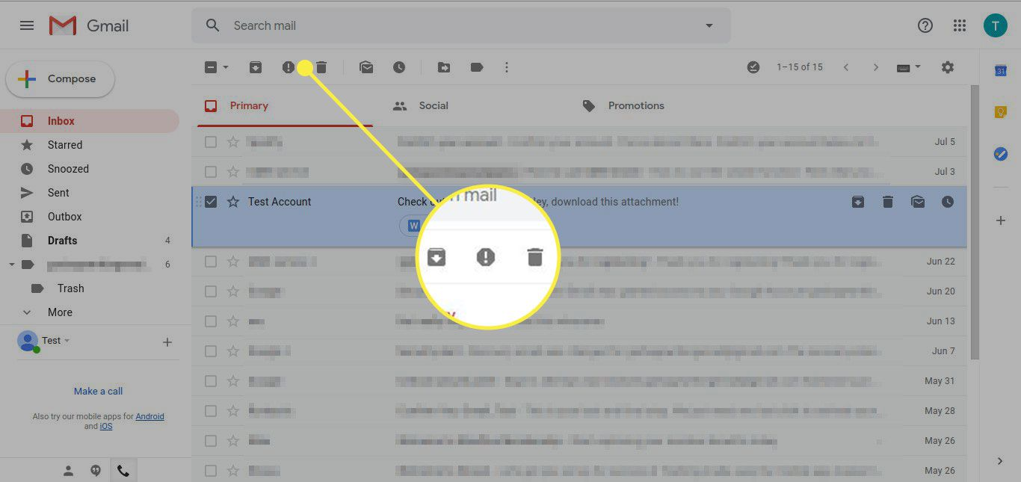
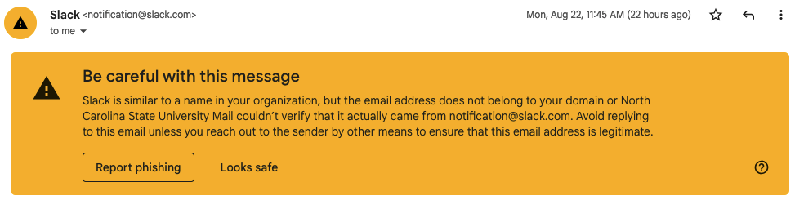
Third method
Having IT perform regular tests to ensure DNS settings and email protections and reporting is in place, and allowing users to directly report/flag emails received, and allow users to directly forward them emails they want to verify
This helps train people to check all of their emails received all the time
This makes sure that the systems in place to detect and prevent fraudulent emails are working

